Slide 1
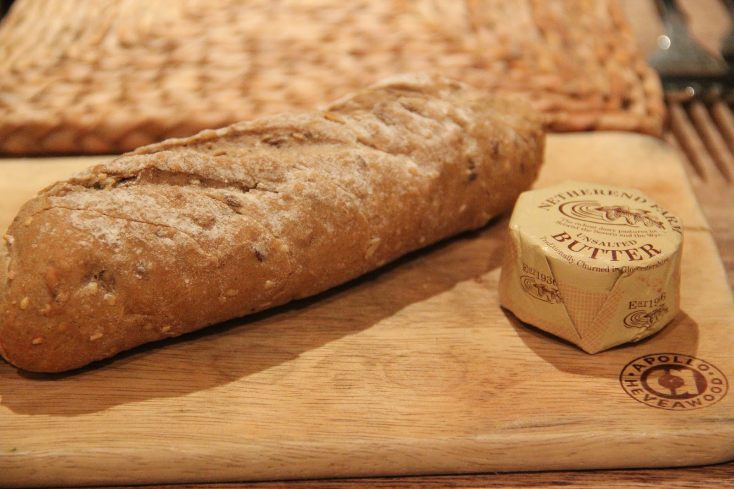
It’s Our Bread and Butter!

Slide 2
Who is General Manager?

Slide 3
Who you really are?

Slide 4
What Drives Profit?
Income Growth
Expense Control

Slide 5
It’s All About Sales!
We sell when we lease
We sell when we answer phones
We sell when we walk the property
We sell when we interact with our residents
We sell when we take a work order
We sell when we deliver late notices
We sell when we work renewals
We sell when we meet with our teams
We sell when we….?

Slide 6
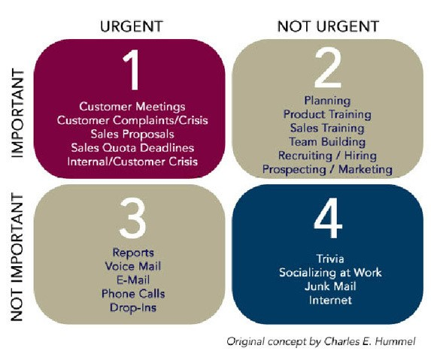
Planning our days
1 – 3 hours
2 – 2 hours
3 – 2 hours
4 - 1 hour

Slide 11
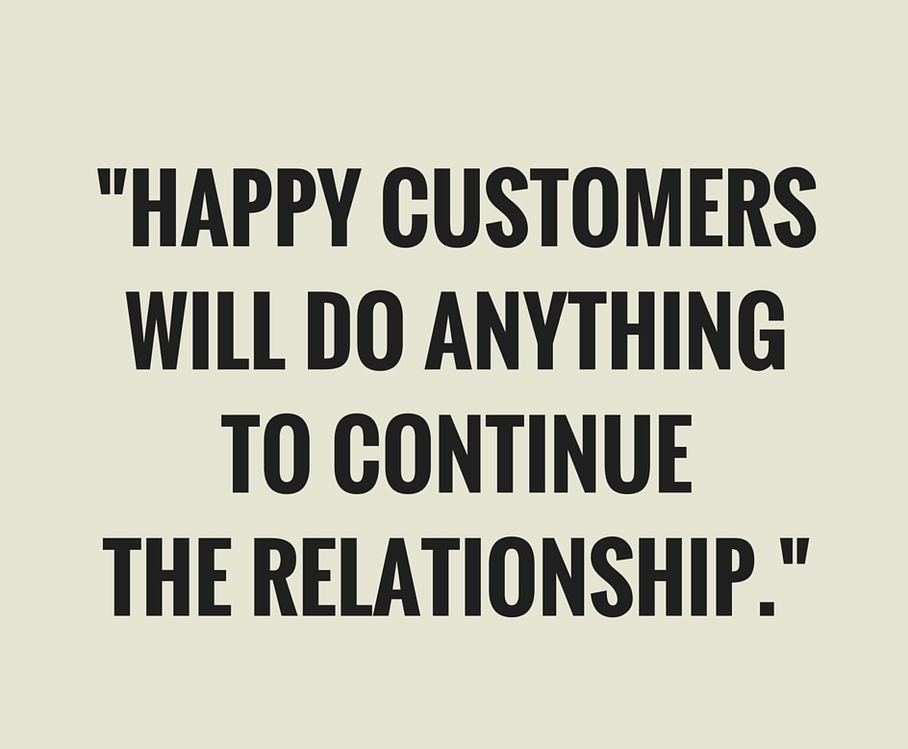

Slide 17
