Slide 1
If Moses were to descend upon us and write the Ten Commandments for salespeople… “Thou Shalt Always Be Closing” will likely be the first one.

Slide 2
Do you have to be an aggressive salesperson to be successful?

Slide 3
NO! you do NOT have to be aggressive but rather effective!
Think about “silent salespeople” … what types of purchases have you made with the help of a silent salesperson? If you bought then the sale was closed!
Notes:
Online Reputation Scores, Print/Newspaper Ad, Radio Commercial, Billboard Sign, etc.

Slide 4
Definition of effective 1a: producing a decided, decisive, or desired effect
Notes:
How many times driving have you decided where to eat based on the billboard you see? How many times have you stopped and purchased something from a clearance rack but it was not what you went into the store to buy? Signage is not even capable of being aggressive -- but signage can be EFFECTIVE and close deals.

Slide 5
Effective Closing techniques are available for every type of customer – no matter what you are selling!
Let’s review 20 of the leading techniques together right now …
Notes:
Irrespective of what kind of sales people you and/or your leasing team are, it doesn’t make you a great one if you haven’t mastered the art of closing. You will soon see how you to evaluate each prospect and situation to determine the best closing technique to use to win the lease!

Slide 6
Assumptive CLose
Notes:
A popular closing technique, the Assumptive close is where the salesperson assumes that the deal has been made. Sales reps use this technique when the prospect has checked most of the boxes in each step of the sales process but has not yet confirmed the deal.
The Assumptive close works because it doesn’t allow the prospect to sit on your offer giving them a time to conjure up issues and objections which can result in them backing out of the deal completely. **My recent experience where the leasing agent said “we will now go back to the office to complete the application together”.

Slide 7
The Take Away Close
Notes:
This works perfectly with prospects too. You’re on the verge of closing the deal, but your prospect is reluctant to proceed. He/she has suddenly come up with complaints in order to drive a bargain. A novice salesman here would comply with all their complaints and offer whatever they ask just for the sake of closing the deal. On the other hand, an experienced sales rep wouldn’t budge.
Using the Take Away closing technique, you can offer to withdraw the whole deal from the prospect in order to push them to accept the offer. This technique can be used for prospects who happen to be a time-sink and take up a lot of your time – with little to show by way of progress.
The reason why it’s effective is that letting go of a potential client shows how confident you’re in your product, which then gets the prospect to reconsider about the good product that he/she may be missing out on.

Slide 8
The now or never close
Notes:
Commonly referred to as the Urgency Close, the Now or Never Close is a sales technique where you place pressure on the prospect to make a decision. This technique works when coupled with a special discount or freebie for a limited period. OR … maybe it is a FACT (not a discount) that creates the urgency such as we now only have one apartment home available for the time you need to move, or only one of the “Hideaway floorplan styles” you desire, etc.
This technique is best used when the prospect is on the line about buying your product. Similar to the Take Away Close technique, a sense of urgency comes into play and the fear of missing out on a discount nudges the prospect over the proverbial line to get your product.

Slide 9
The summary close
Notes:
Think of a well-executed closing argument delivered by a trial attorney in court. There are no new facts or concerns introduced here. Just a simple act of selectively summarizing the highlights and the pointing towards the only logical conclusion from connecting the dots.
Summary close works great when you have gone through an extensive discussion/ evaluation over a period of time and it is now time to switch gears.
Dog wash station – saves time and money, Fitness Center – saves time and money, Green Enthusiasts – Bike Center, Recycling.

Slide 10
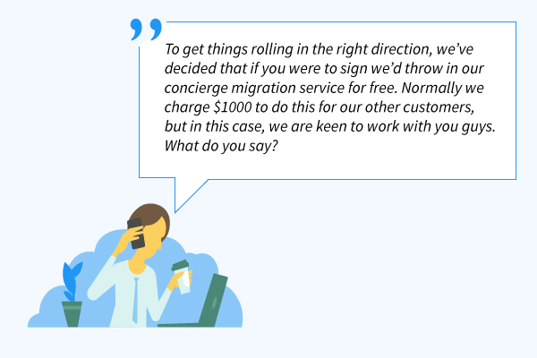
Something for nothing close
Notes:
It has been proven that it is a social norm of responding to a positive action with another positive action. (THINK – Pass it Forward)
The Something For Nothing Closing Technique works around this concept. You give your prospect a free add-on or an extra feature in goodwill and they will be obligated to do something in return – that something, in this case, can be leasing the apartment home.
Something For Nothing works because people like free things. But just to keep things clear, the freebie you give should be of value to them and less value to you.

Slide 11
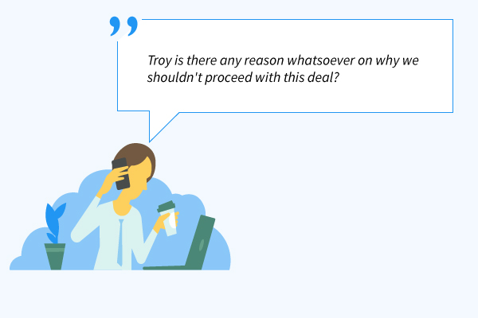
The objection close
Notes:
Once you have made sure that your prospect has understood everything about your apartments and community and what it has to offer, try closing the deal by asking them for any objections they might have.
This approach allows the prospect to raise any final objections or doubts that they need to clear up without saying no to the deal.

Slide 12
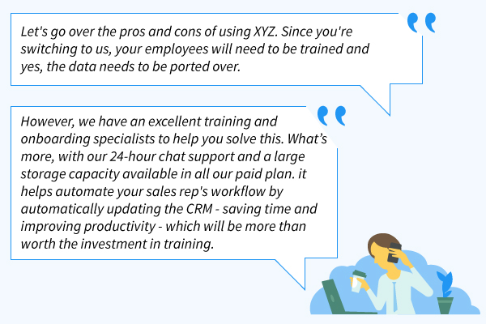
The Ben Franklin Close
Notes:
Benjamin Franklin was not only a great inventor and politician, he was also a brilliant businessman. Whenever he was hesitant about something, he’d list down the pros and cons of the decision. This simple tactic has enormous potential when it comes to sales closing.
Listing down the pros and cons of your apartments / community will help the prospect visualize how valuable your home can be for them. It’s best used when the prospect is hesitant whether to lease or not, you can make them list down the pros and cons and once they see that the pros outweigh the cons, the odds of you closing the deal improves.

Slide 13
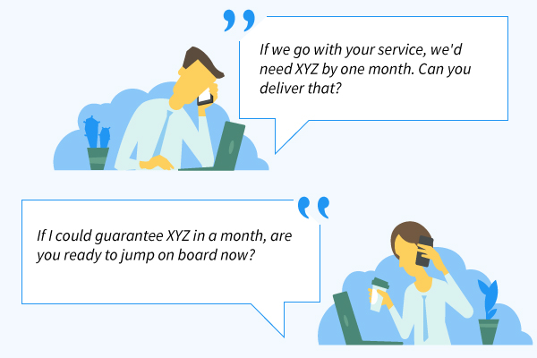
The sharp angle close
Notes:
The Sharp Angle Closing Technique is best used when the prospect is most likely going to rent your apartment, but they have one nagging objection that is stopping them. They bring this objection in the form of a challenge like ‘can you deliver’ or ‘there is an issue’ or so on. Using the sharp angle tactic, you can answer this question with another relevant question in the hopes of closing the deal.
If you get a positive response, the deal is done and dusted. Otherwise, if you happen to get a negative reply, you know that they’re either not serious or there is another issue. Here you are given a second chance to clarify any other issues they have.

Slide 14
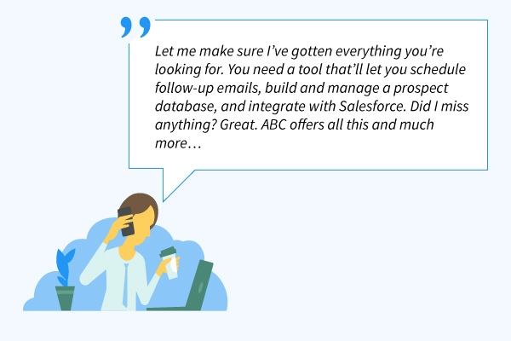
The needs close
Notes:
Satisfying a prospect’s needs is the best way to get them to lease and that’s what the Needs Close sales technique does. First, list the things the prospect said they needed from your apartments/community. Then review the list against what you have to offer and start ticking off the boxes that match. The more boxes ticked, the better fit the home is for the prospect.

Slide 15
The scale close
Sales Rep: “On a scale of one to ten, how interested are you in our apartment homes?”
Prospect: “I’d say an eight.
Sales Rep: “Wow! That is Great. Just curious, what did you like so much that made you give us an eight?”
Prospect: “We love the location, private patio, and washer/dryer in the apartment.
Sales Rep: “Most of our residents love us for those same reasons and I agree these are great reasons, but I’m curious why you did not give us a ten?”
Prospect: “Despite your apartments having such great features, we feel that it’s a little too pricey.”
Sales Rep: “I agree. But when you start living here, you will realize that you will save money on gas since we are centrally located in the city. You will also save money with your in-home laundry machines. We have never had customers complain that living here is saving them too much money”. ☺
Notes:
Before closing a sale, if you need a vague idea of how interested your prospect is in your community, it’s best to approach them with the ‘On the scale of 1-10′ line.
Based on how they rate, you can either clarify their objections if the score is low or proceed to close the deal if they give you a solid high score. This will help you analyze the prospect’s interests and gives you a chance to walk them through any concerns they might have.

Slide 16
The visual close
“These past few months have brought about some fruitful conversations between us and I’ve appreciated the time and effort you have put into apartment shopping with ABC apartments. I hope you feel the same way. Ever since we started working together, this is how far we have come…”
1.) Toured community social areas and 2 bedroom townhouse floorplan
2.) toured 2 bedroom / 2 bath garden apartment
3.) Toured 1-bedroom with den upstairs apartment
4.) took a scenic tour of all available apartment homes using the property map
5.) discussed our pet friendly guidelines
6.) reviewed the application process
7.) discussed lease guidelines
“Here is the good news. We have successfully completed all the steps required to make sure you enjoy your perfect new home at ABC apartments. All that is left is to put pen to paper. When would you like to complete the application?”
Notes:
Using visual aids such as floorplans, property maps, lease examples, local attraction calendars, bus schedules, etc. you can close deals in a more attractive manner. The Visual Close technique is quite popular among sales reps because it appeals to a prospect’s visual perception and as we all know, a picture is worth a thousand words.
It’s easier for the prospect to visualize what you’re trying to put forth. After all, the human brain processes an image 60 thousand times faster than it processes words.

Slide 17
The empathy close
Notes:
Not every deal has to be closed using leverage or pressure. Sometimes it’s good to take the empathy route.
The Empathy Closing technique allows you to use emotion to understand the situation your prospect is in. When the prospect tells you that he/she isn’t ready to make a decision, it’s sometimes good to them more time to think than rather pushing for a close.
Empathizing with your prospects can help build a special bond with the prospect which can be useful in the long run. Just be sure to gain “next steps” before closing the communication.

Slide 18
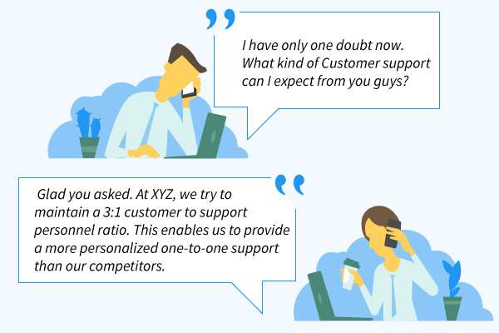
The artisan close
Notes:
The Artisan Closing technique lets you highlight the amount of work, skill, and time that is being invested into your community. It deviates from the usual sales closing technique norms by focusing more on the behind the scenes of your product, rather than the prospect or the benefits of your product.
This technique works best with prospects who are appreciative of something that has a lot of effort and hard work put into it. Emphasizing on that puts your product in good light and brings new appreciation to the eyes of the prospect, making it easier to close. We employ 1 office and 1 maintenance personnel for very 100 units to ensure adequate staffing to keep ABC Apartments running efficiently. We have service contracts for lawncare and snow removal so that your home is well kept year-around and serviced by professionals. We will be resurfacing the parking lot this year.

Slide 19
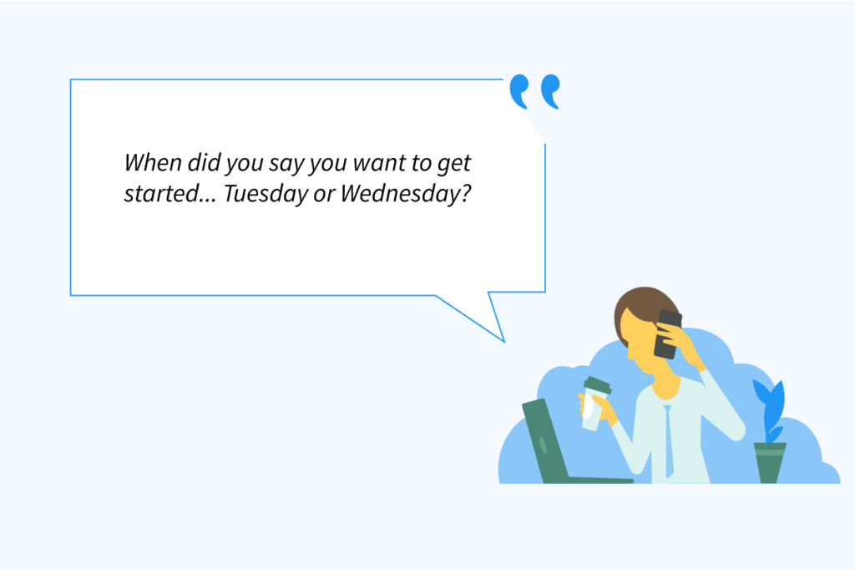
The alternative close
Notes:
The Alternative Close is a variant of the Assumption close (first one we discussed), where you assume that the prospects are interested your product but here you will provide them 2 alternative choices that will move the deal forward. The catch is, whatever choice they choose, it should invariably help you take a step towards the close. This closing technique works best with prospects who don’t have any queries on your product or any objection with the price, features, etc.
Why is it effective? By giving them choices, you simplify the decision-making process and easily get them to make a commitment to your product.
Will Thursday or Friday be better for you to complete the application? Should I email you an application as an attachment or do you want me to send you the hyperlink in an email? Would you like to use our computer in the leasing office /business center to complete your application or do you prefer to complete it by hand?

Slide 20
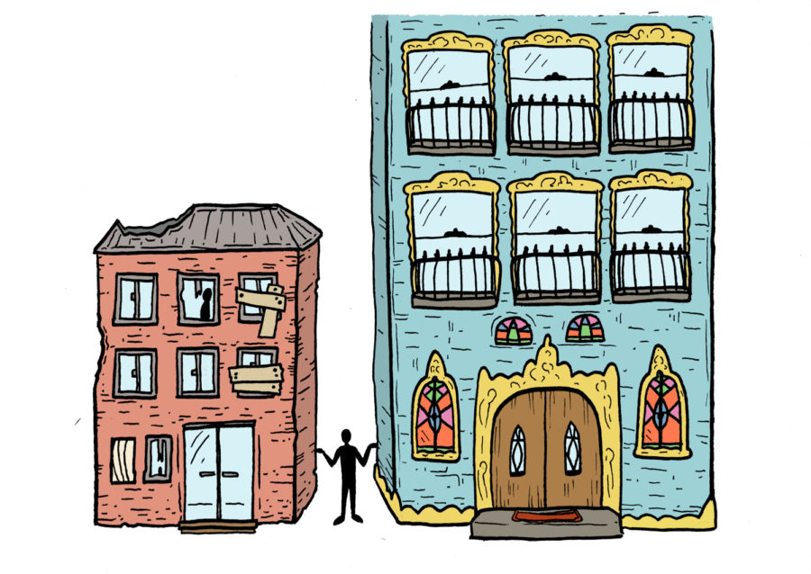
The opportunity cost closing
Notes:
In business terms, Opportunity Cost is the cost of forgoing something. I.e. the cost you incur by NOT doing something. This closing technique taps into the same principle by stressing on what the prospect will miss out if they do not lease from you.
When using the Opportunity Cost close technique, insist why renting your apartment home is not another increasing expenditure but rather an investment – highlight the new windows/furnaces/roofs the owner just installed - they all will save resident’s money on utilities. Highlight the pet grooming station – saves on pet care. Highlight gas savings if moving closer to work, etc.The idea is to make the prospects realize that the longer they take to lease, the more they will stand to lose.

Slide 21
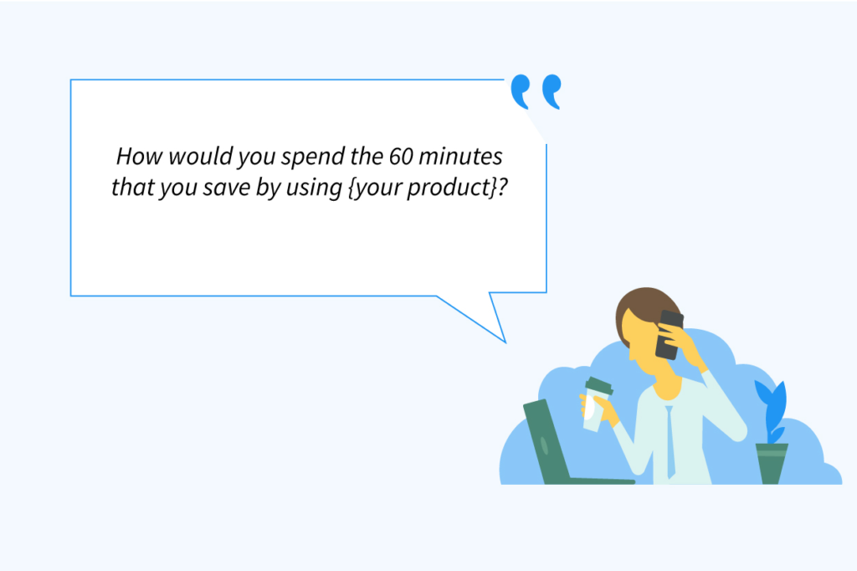
The ownership close
Notes:
Have you come across one of those car salesmen who make a sales pitch, talking as though you already own the vehicle – Your next vacation is going to be much more cost effective with all the gas you will save driving this new Hybrid. Classic Ownership close; where the seller firmly places the idea of the buyer owning the product.
Using this technique, you paint a picture of the prospect’s lifestyle will change for the better;
-I bet you will enjoy having direct access to the Monon Trail while living at Mezz 42, as I am sure driving to the trail every night gets to be hassle..
-What are you going to do with the extra hours in the day you will gain by living only 5-minutes from work? By repeatedly stating the benefits that they will enjoy, you create a mental closure that your apartment home will improve their lifestyle, thus making it easy for you to finalize a deal.

Slide 22
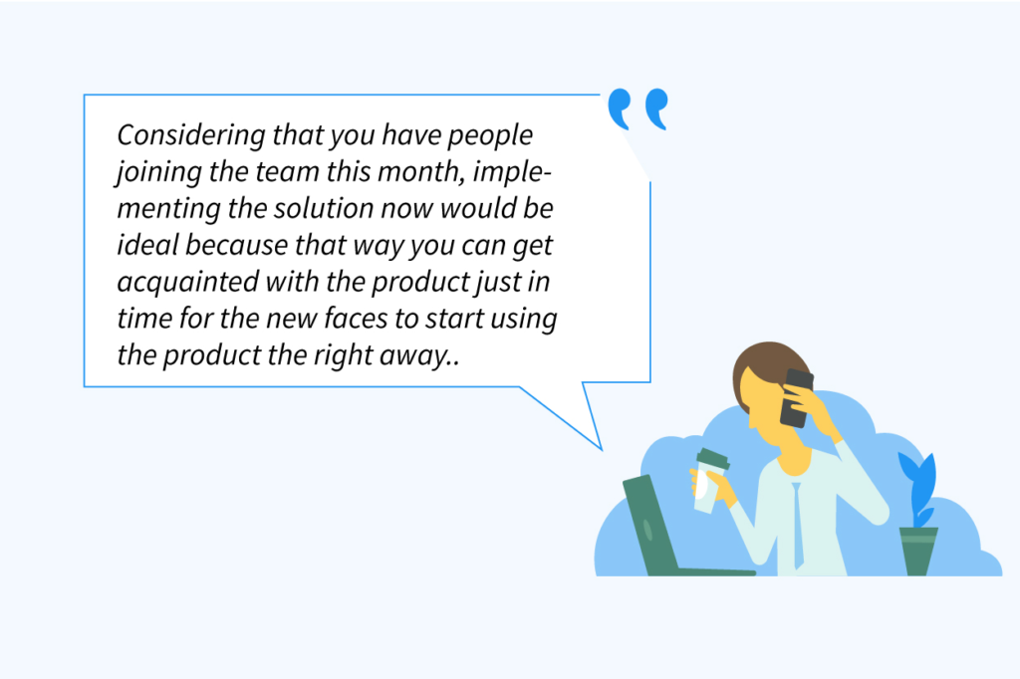
The best time to close close
Notes:
The ‘Best Time to’ close is a very effective technique to use when you notice there is a trigger event related to the prospect – you use the timely happening to persuade the prospects, why now is the right time to lease your apartment:
Examples:
Is the prospect getting married?
Is the prospect’s family size growing/downsizing?
Is harsh winter weather on the way?
Are the Holiday fast approaching?
Are you offering a concession or special promotion?
Basically, you relate the timely happening with your apartments and put forth convincing statements that emphasize why it is the best time to lease.

Slide 23
The calendar close
Notes:
There will be some prospects who will be on the fence when it comes to completing the application.
You cannot wait forever for them to make up their mind; at the same time, you cannot give up on them either, because they are almost near the closing line.
What do you do, in that case? You suggest a date in the near future to finalize the deal.
This way, you eliminate the hassles of back and forth exchanges and clearly fix a timeframe by which the prospect should come to a decision.
Based on their response, you can also identify the level of commitment of the prospect in signing a deal.

Slide 24
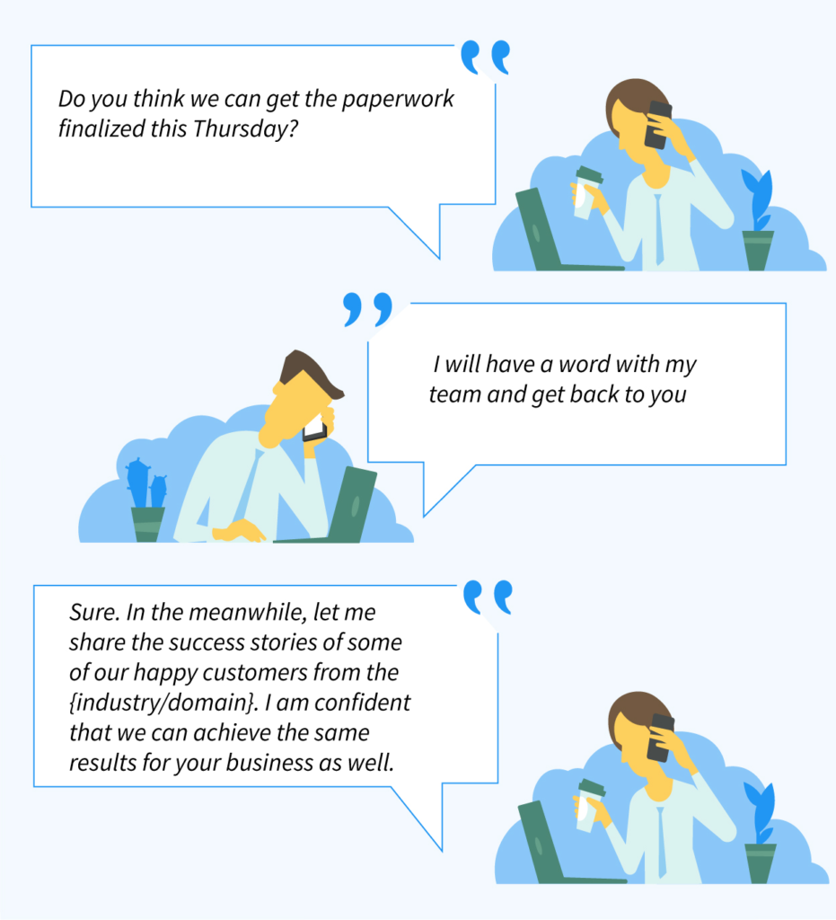
The testimonial close
Notes:
The Testimonial close is a powerful technique which helps you build trust and credibility with prospects which are the key factors for any business relationship.
When using this technique, instead of talking about your apartments / community yourself, you share the experiences of actual users who have benefitted from living there. Testimonials are effective because, they come from people who have actually used the product and fell in love with it – their opinions are neutral, genuine and free from any bias.
The other reason why this technique works is that when you share the success stories of your users who are similar to the prospects, you ease their concerns and doubts on whether your apartment will make them happy.

Slide 25
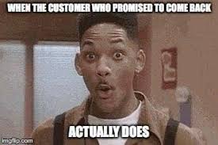

Slide 26
Always Be closing
Always!

